Slide 1
Capstone Project - 4 Customer Segmentation By- Shri Prakash Yadav

Slide 2
Points of Discussion
Problem Statement
Data Summary
Bivariate Analysis
Univariate Analysis
Correlation
RFM Analysis
Clustering
RFM Clustering
Conclusion
Challenges

Slide 3

Problem Statement
Customer segmentation is the process by which you divide your customers into segments up based on common characteristics such as demographics or behaviours, so you can market to those customers more effectively.
Customer segmentation is one of the most important marketing tools at our disposal, because it can help a business to better understand its target audience. This is because it groups customers based on common characteristics. These groups can be used to build an overview
of customers.

Slide 4
Data Summary
The Dataset I have been provided with is Online Retail dataset. It is a big dataset consisting of 541909 rows and 8 features. The features are listed below:
InvoiceNo: Invoice number. Nominal, a 6-digit integral number uniquely assigned to each transaction. If this code starts with letter 'c', it indicates a cancellation.
StockCode: Product (item) code. Nominal, a 5-digit integral number uniquely assigned to each distinct product.
Description: Product (item) name. Nominal.
Quantity: The quantities of each product (item) per transaction. Numeric.
InvoiceDate: Invoice Date and time. Numeric, the day and time when each transaction was generated.

Slide 5
UnitPrice: Unit price. Numeric, Product price per unit in sterling.
CustomerID: Customer number. Nominal, a 5-digit integral number uniquely assigned to each customer.
Country: Country name. Nominal, the name of the country where each customer resides.

Slide 6
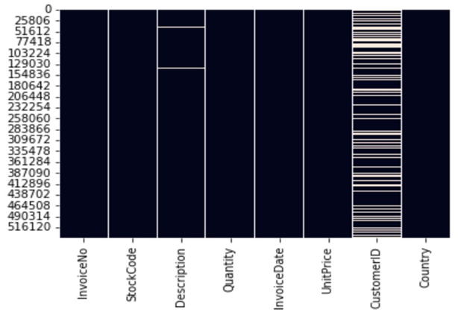
NULL Values

Slide 7
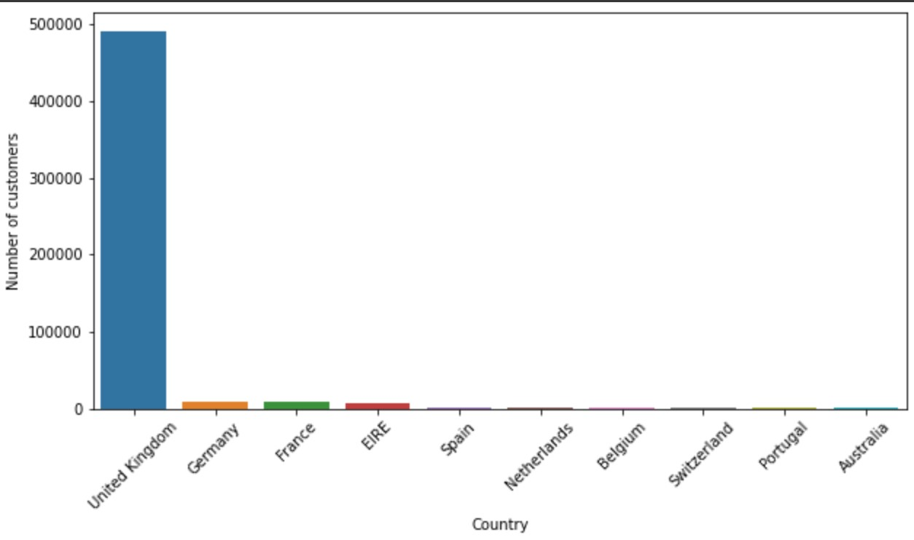
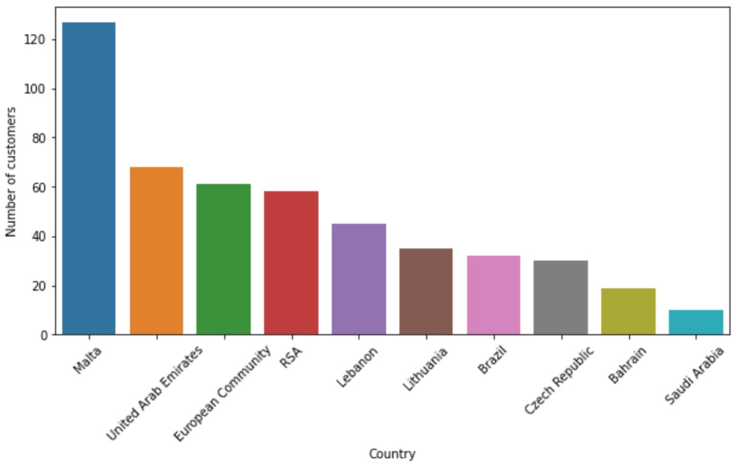
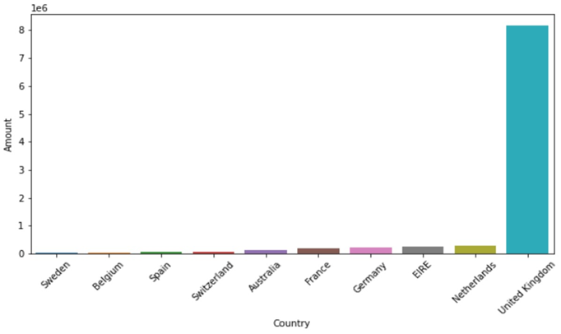
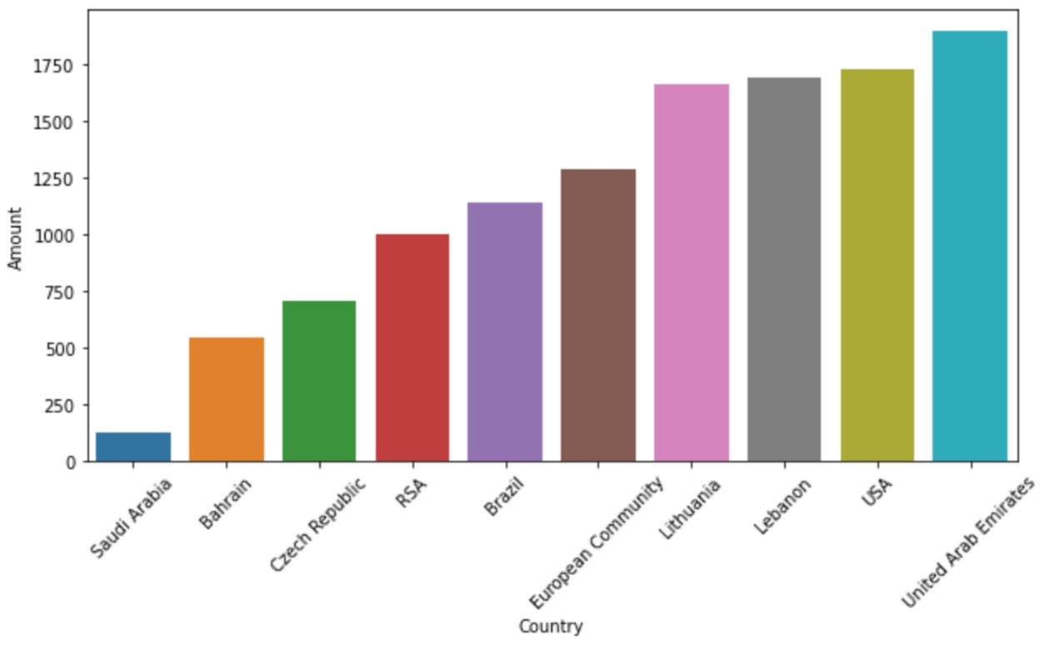
Bivariate Analysis

Slide 8
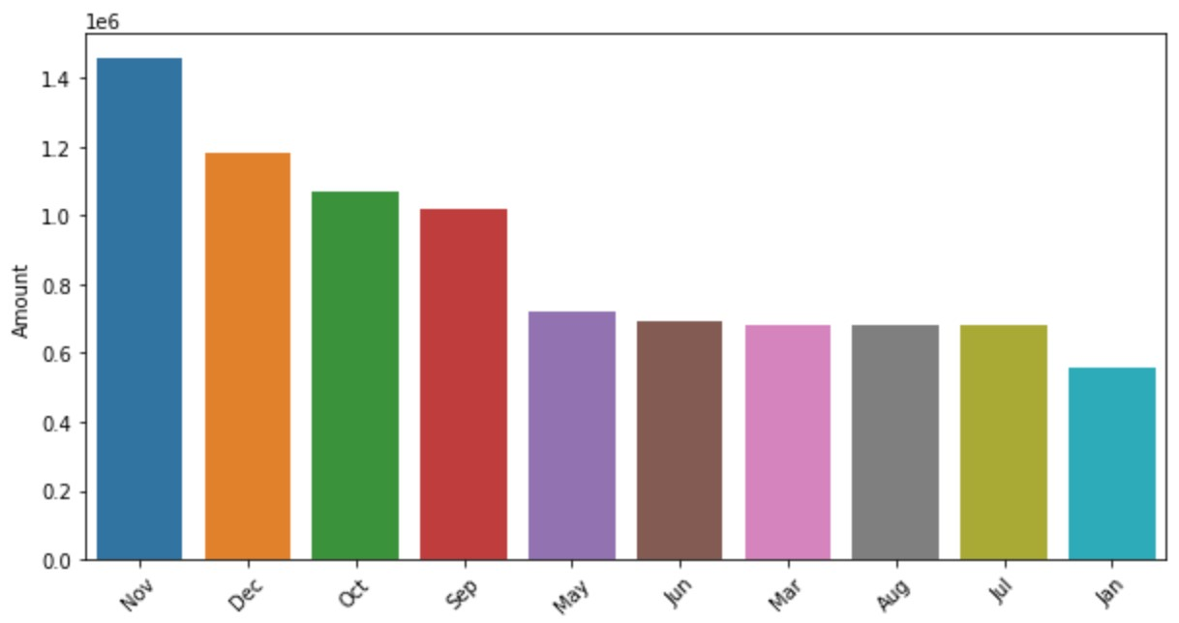
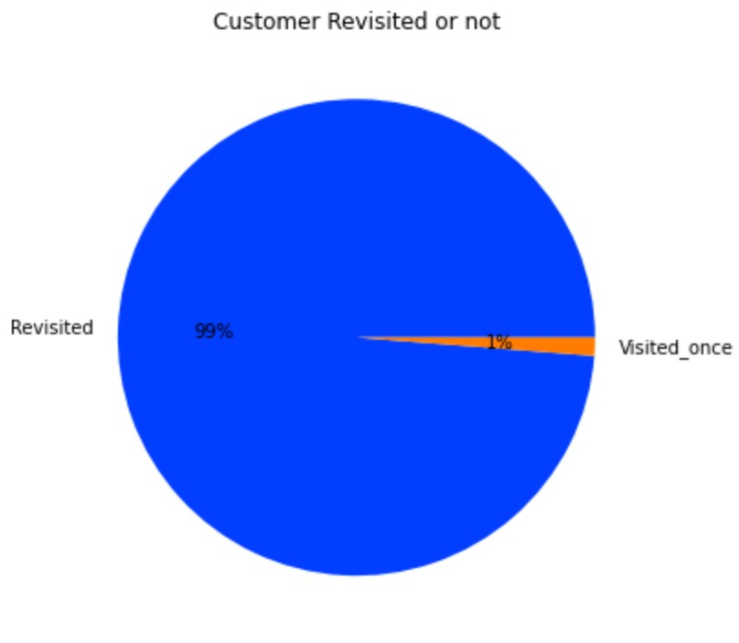
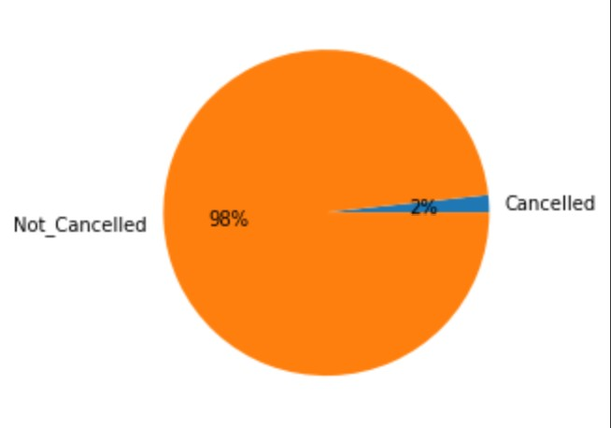
Bivariate Analysis

Slide 9
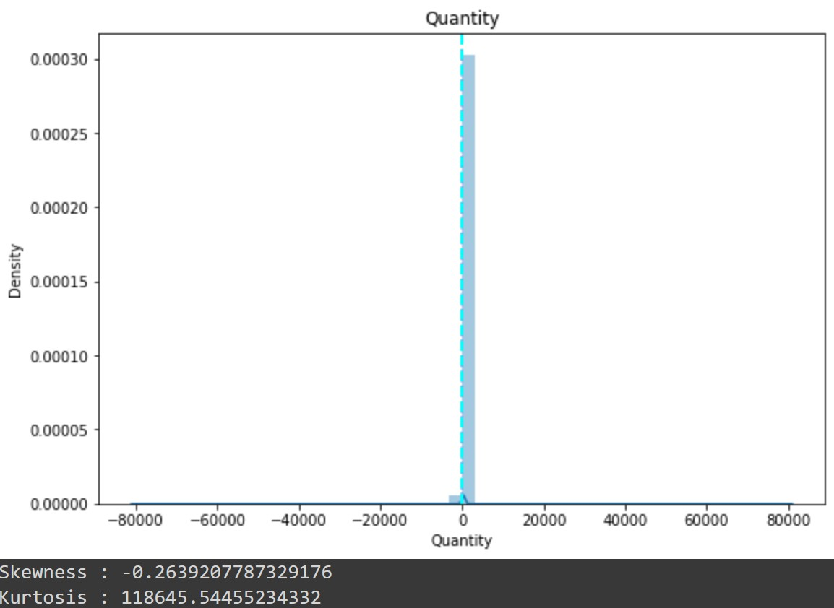
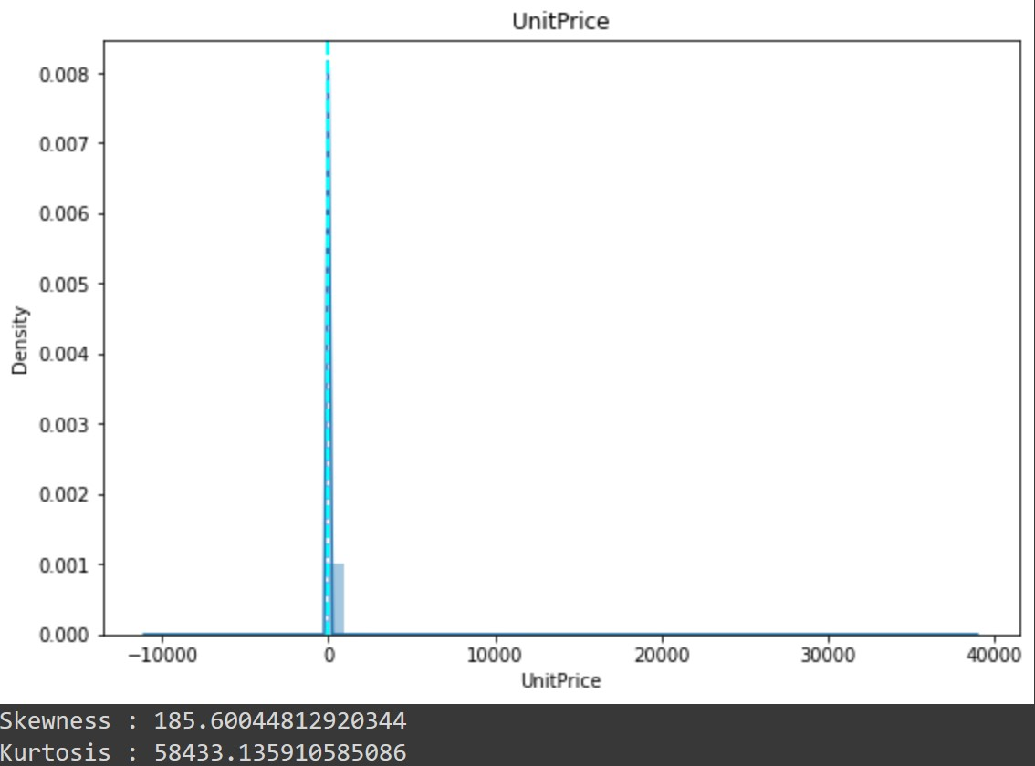
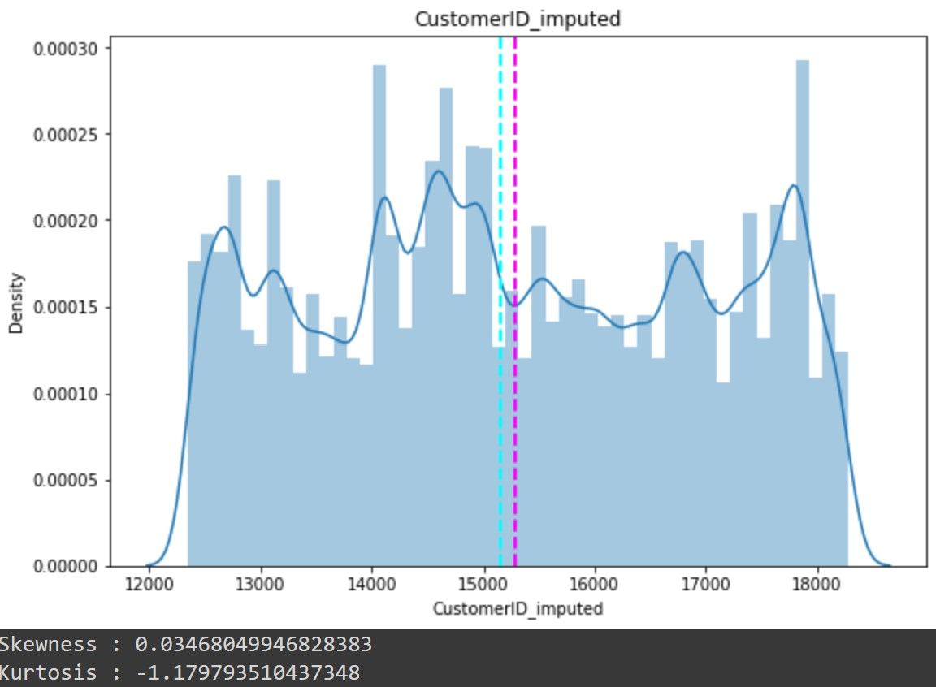
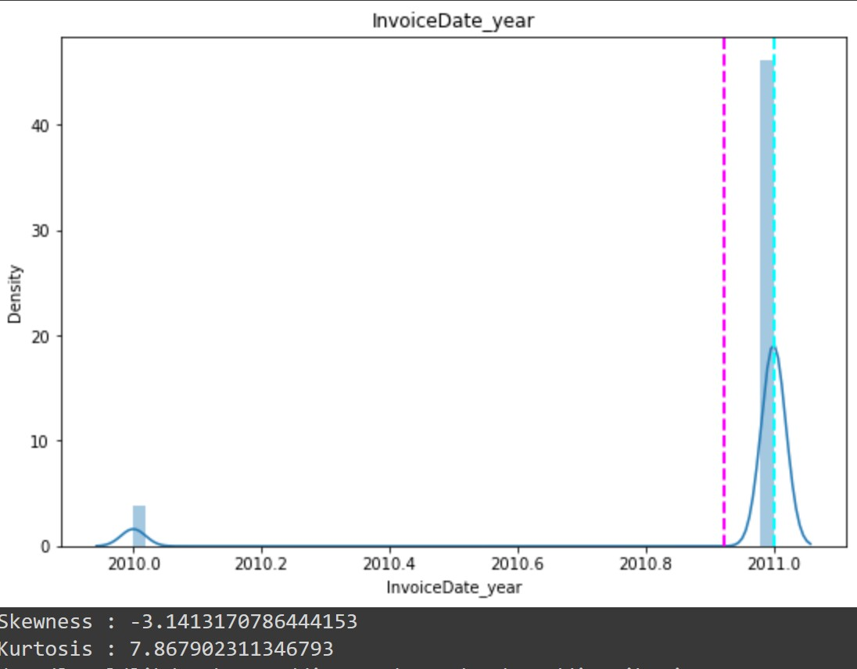
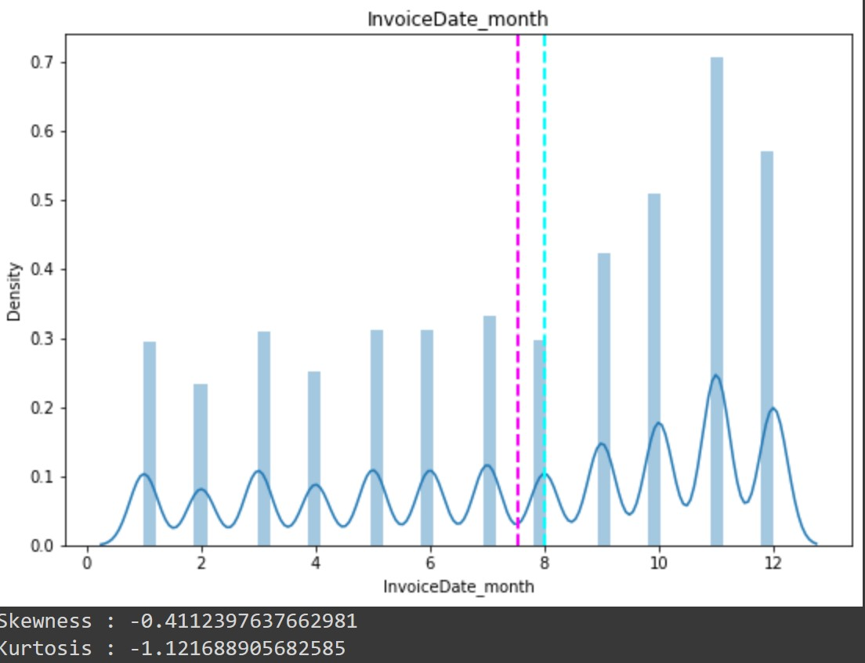
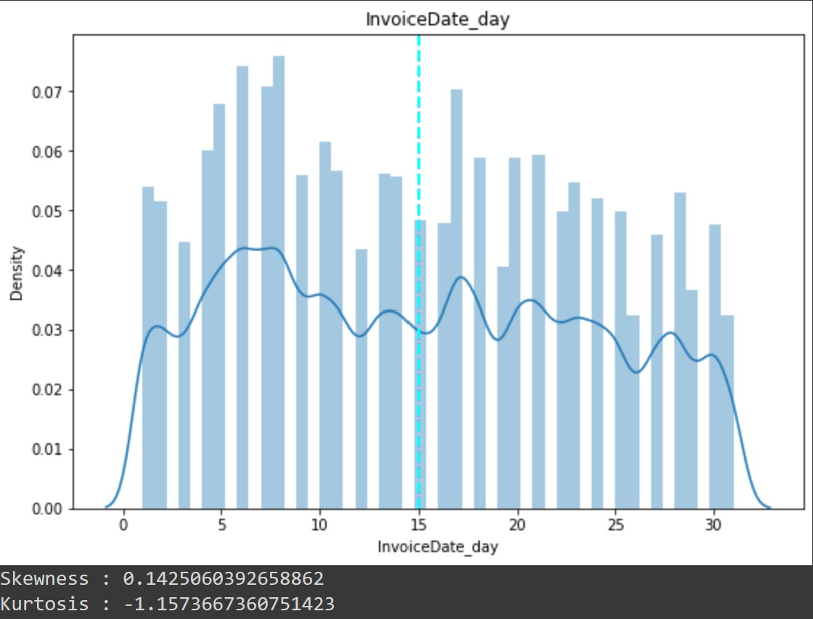
Univariate Analysis

Slide 10
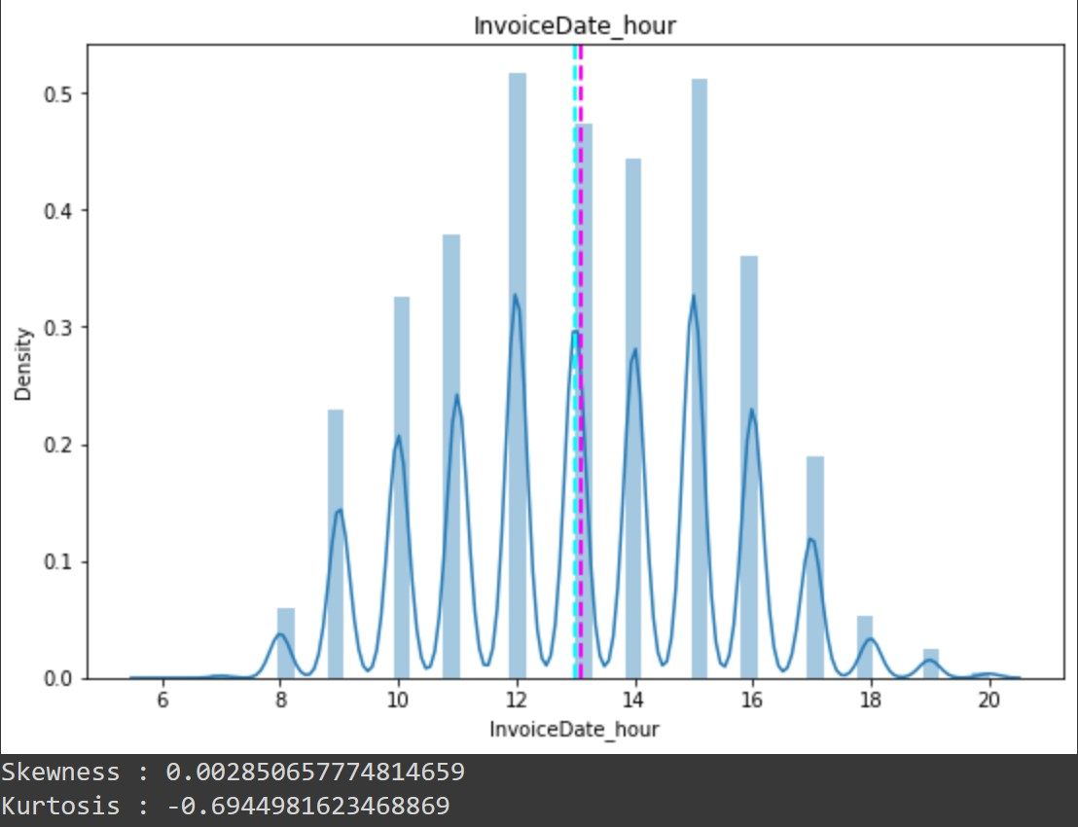
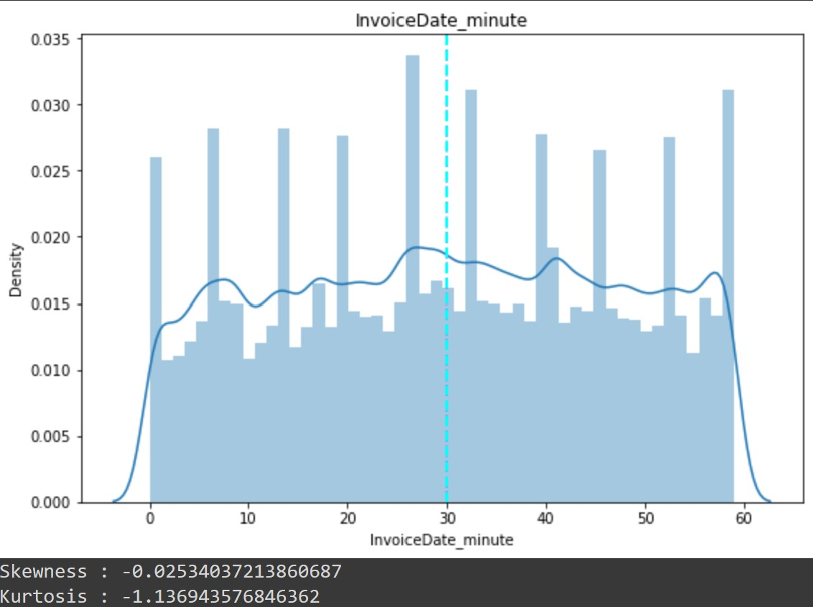
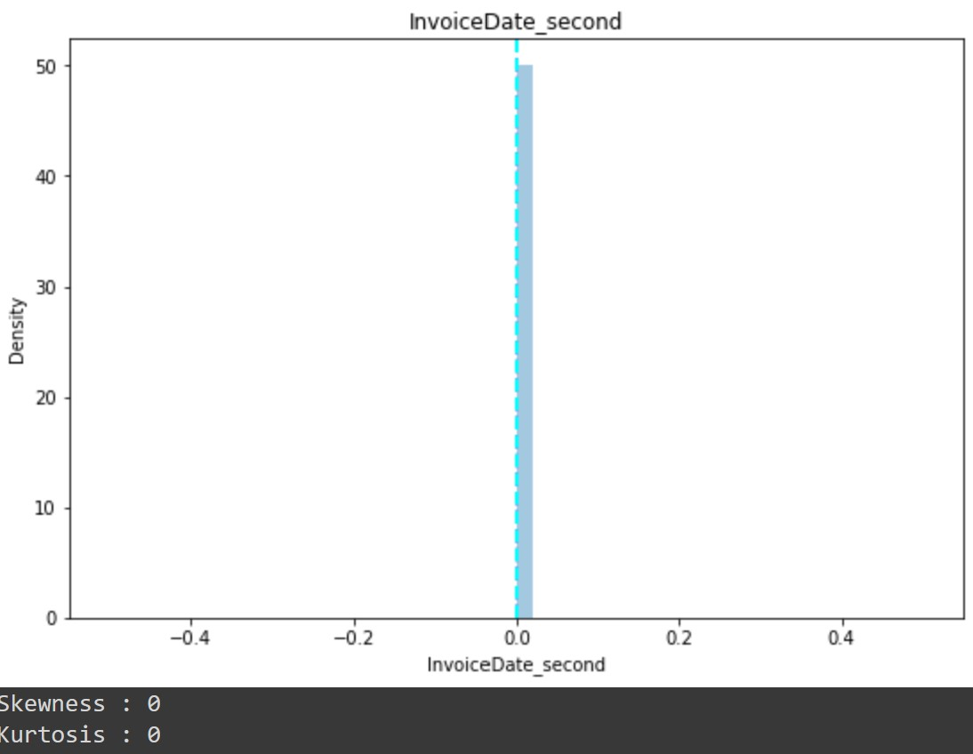
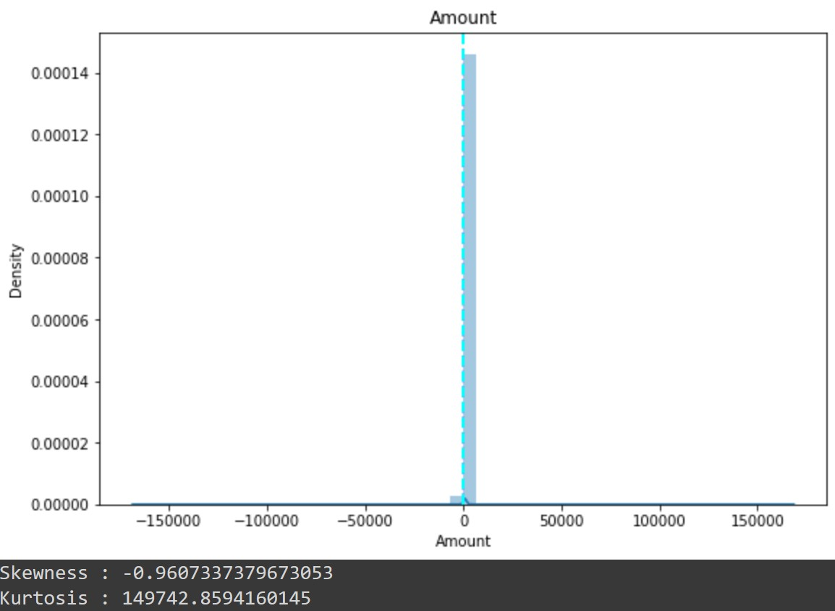
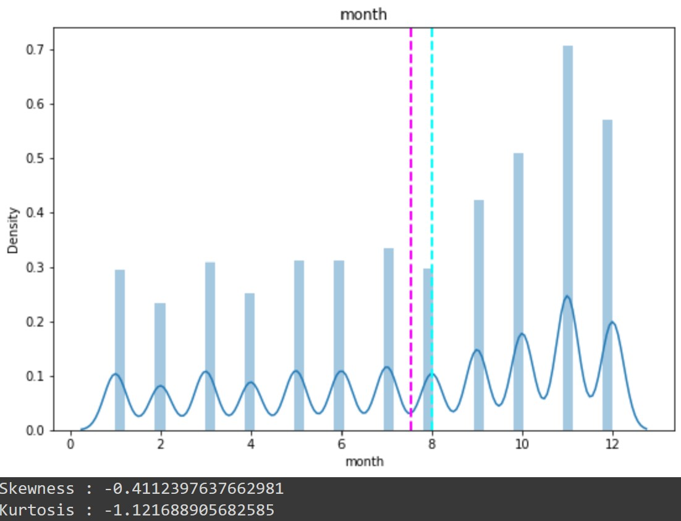
Univariate Analysis

Slide 11
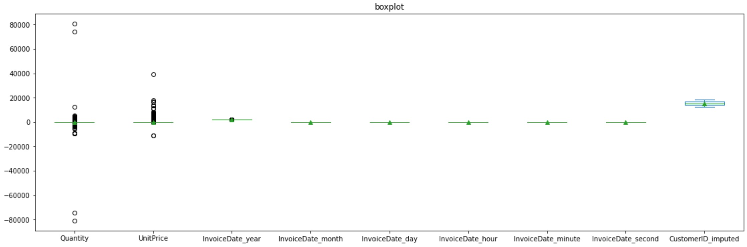
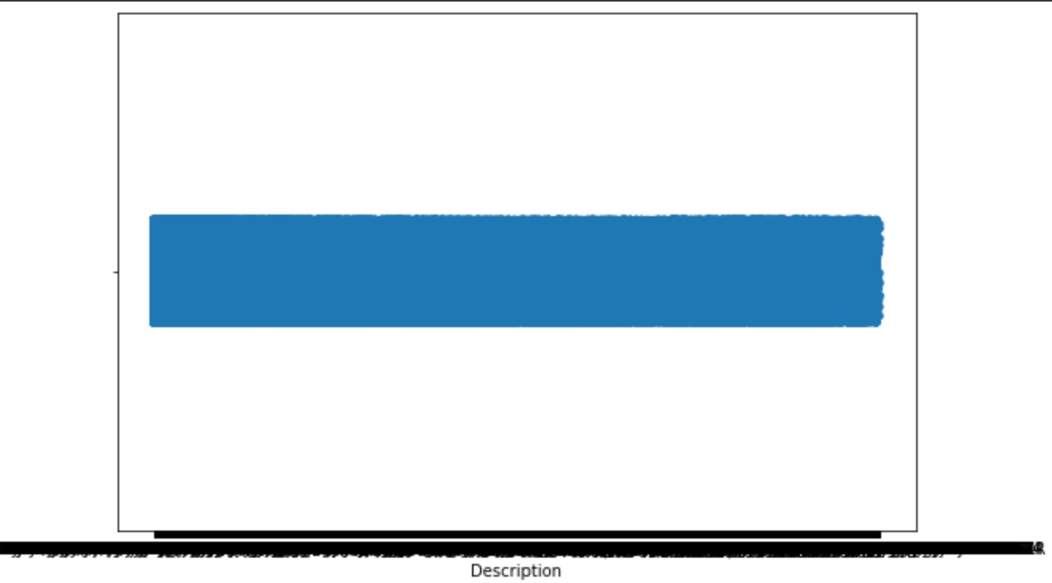
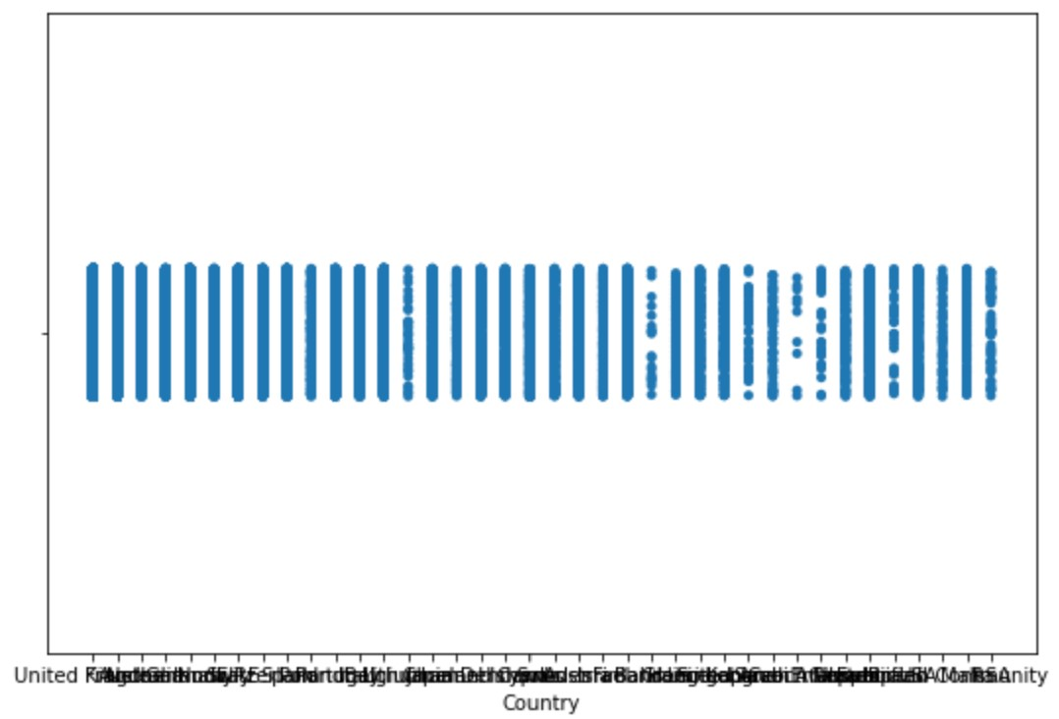
Univariate Analysis

Slide 12
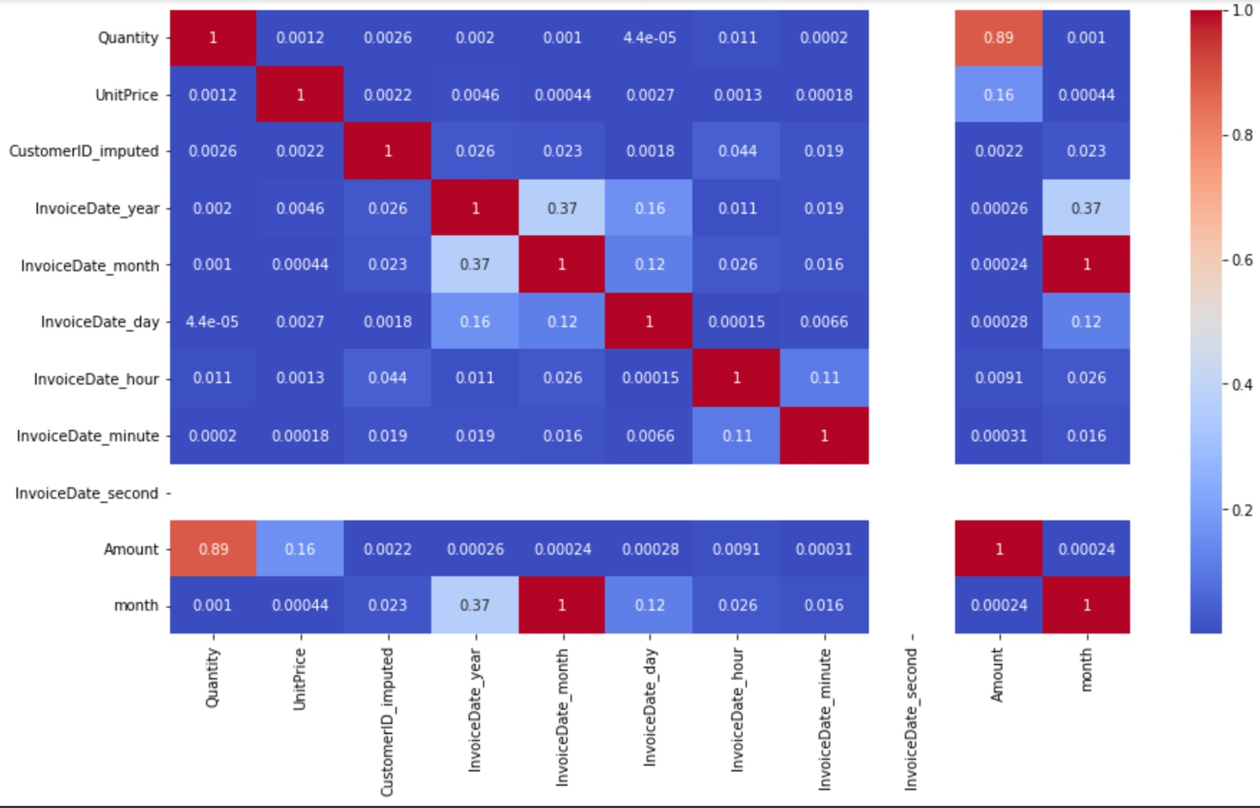
Correlation Matrix

Slide 13
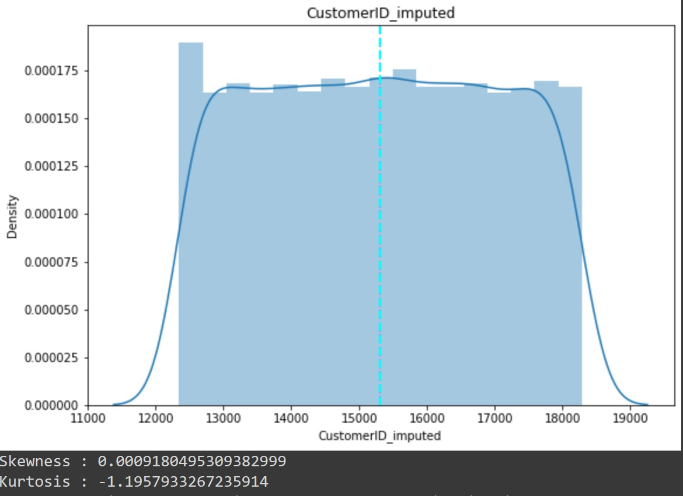
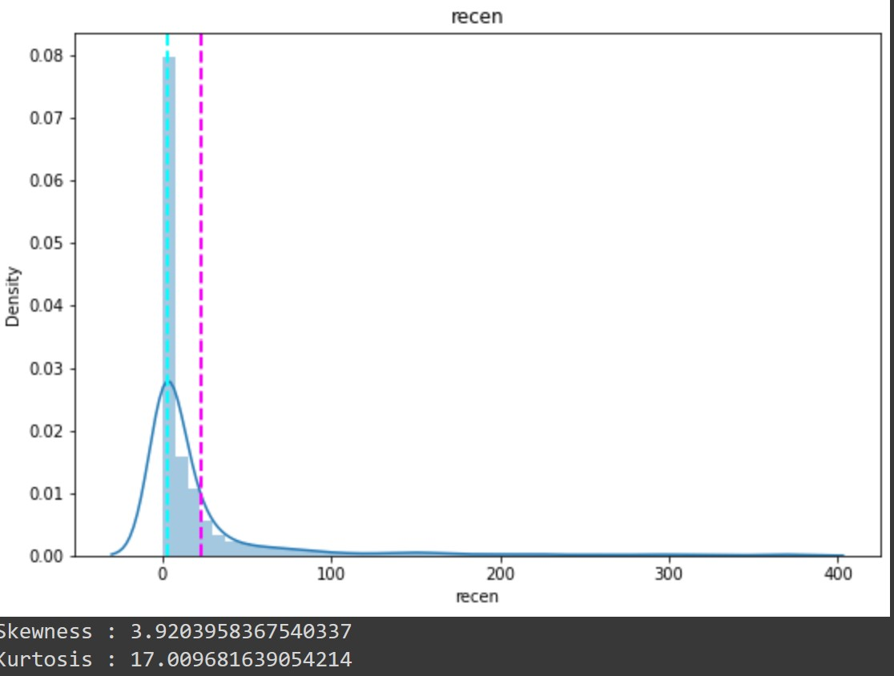
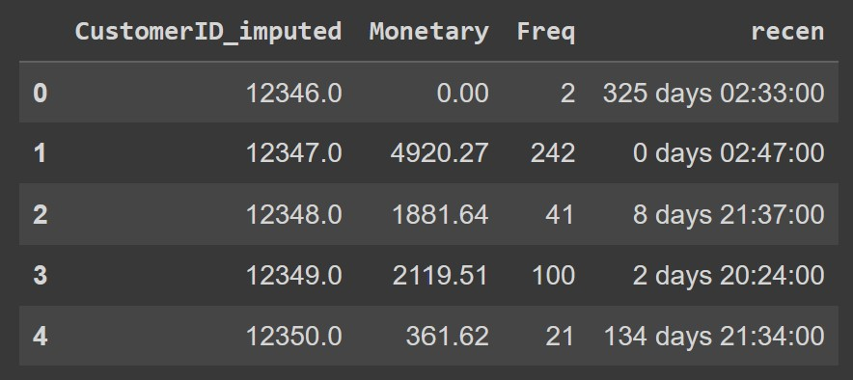
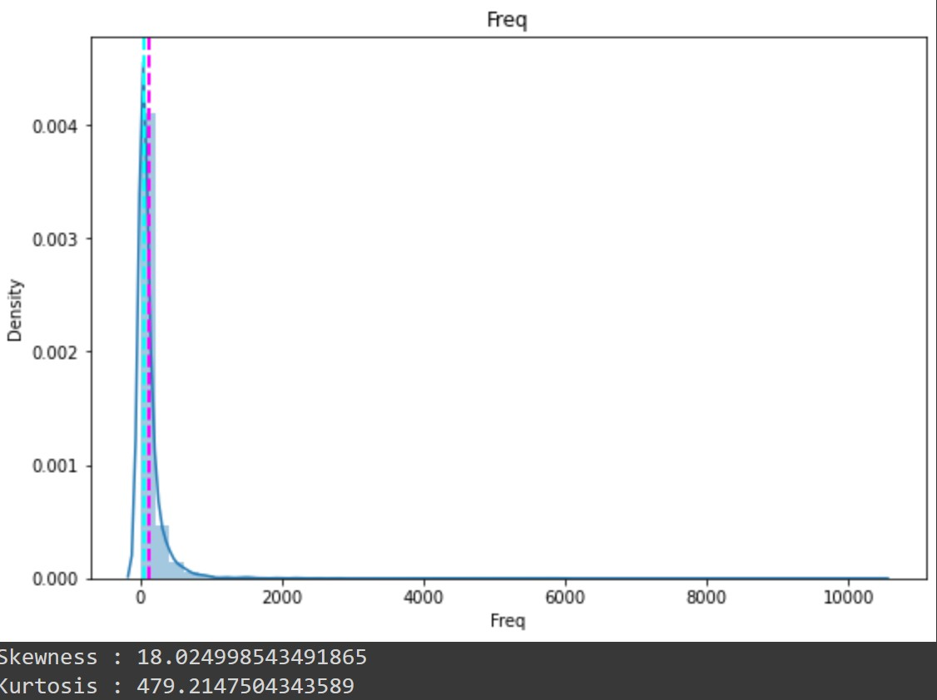
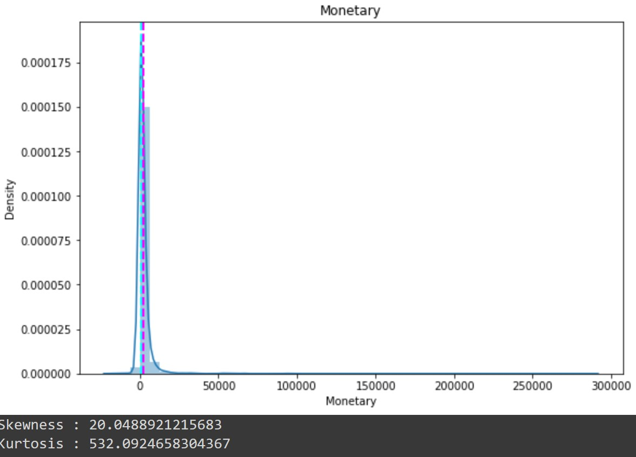
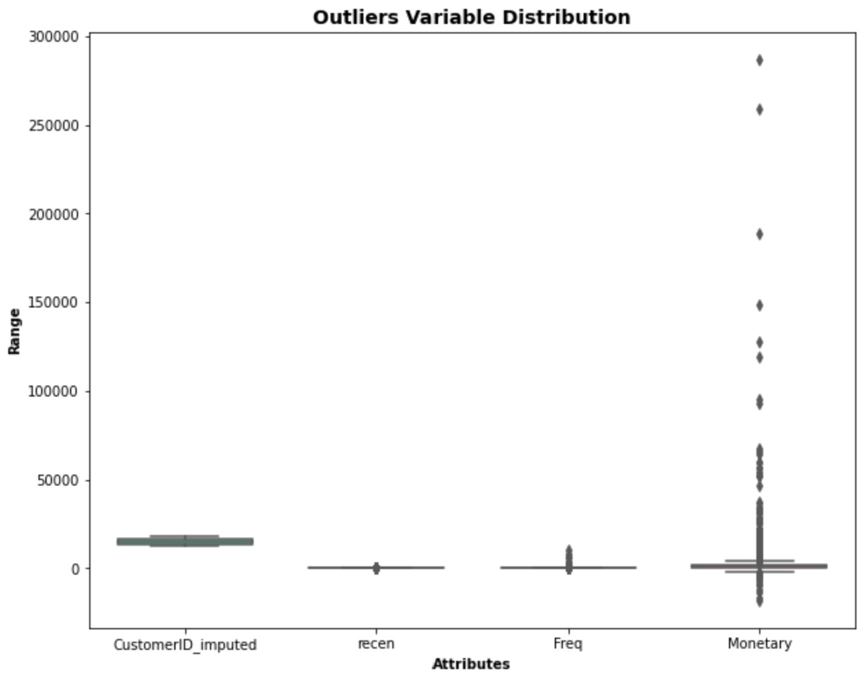
RFM Analysis

Slide 14
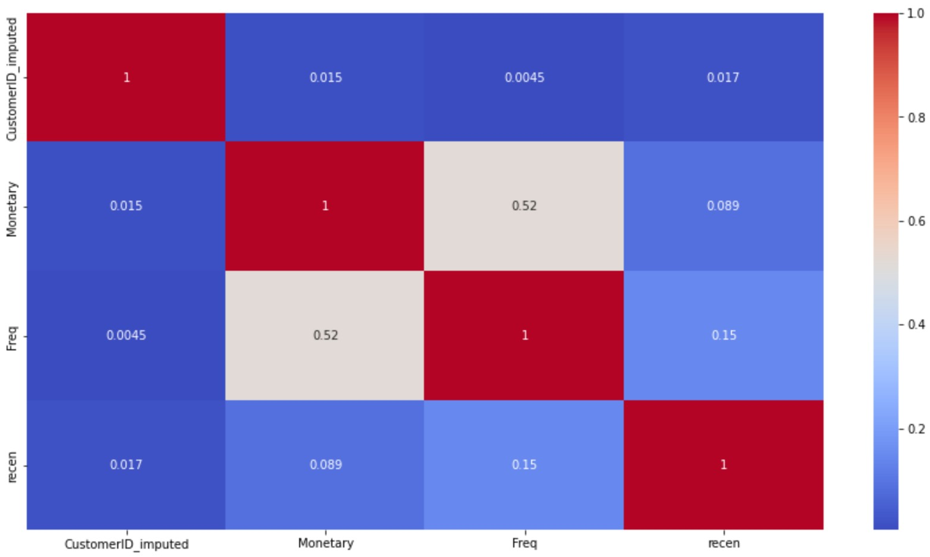
RFM Analysis

Slide 15
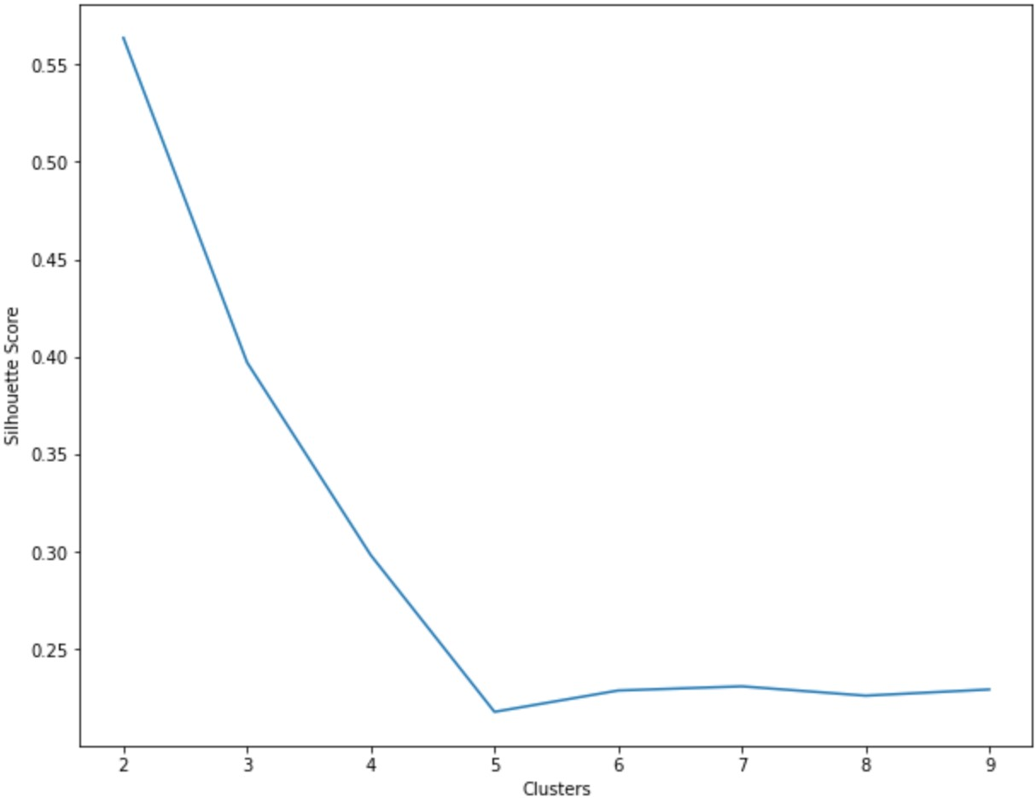
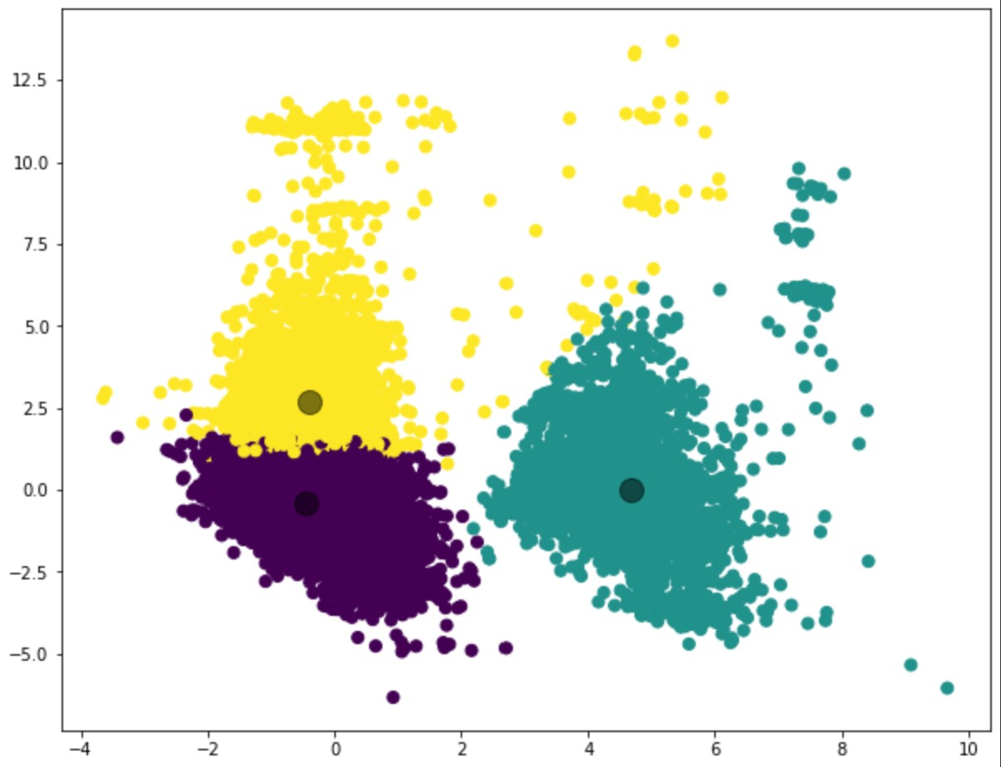
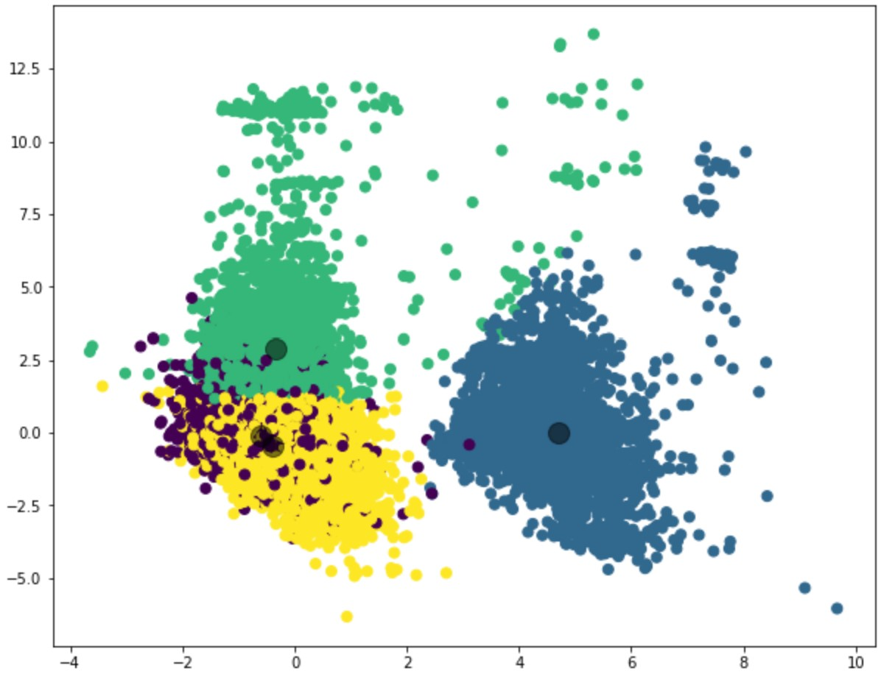
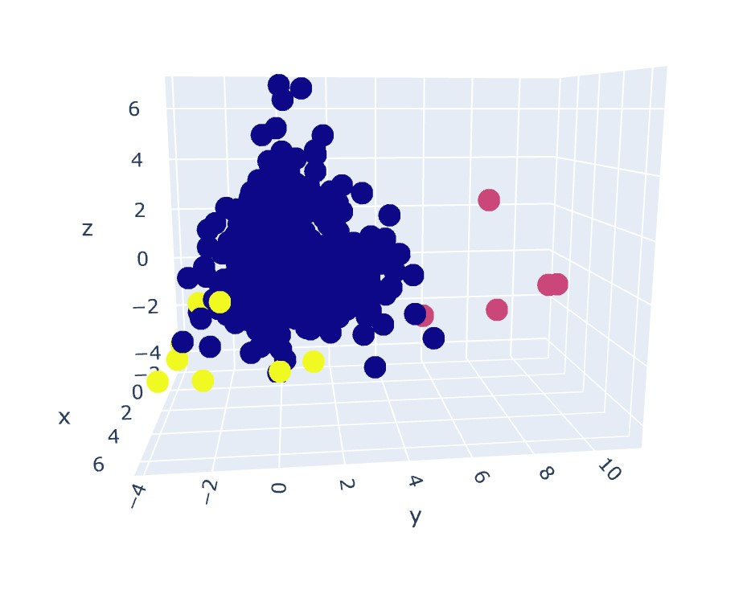
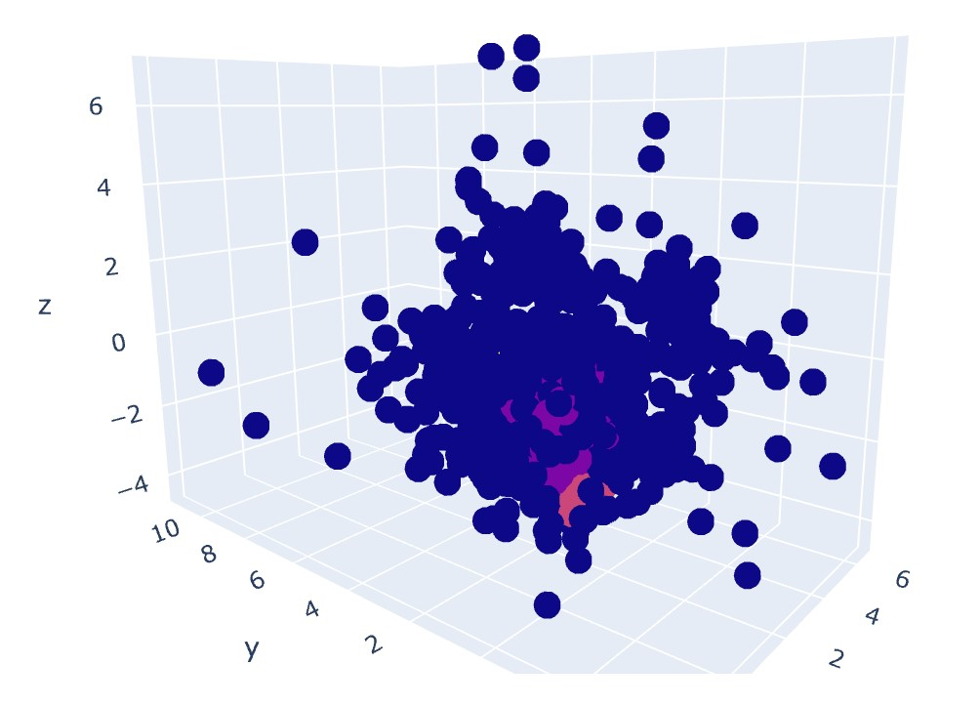
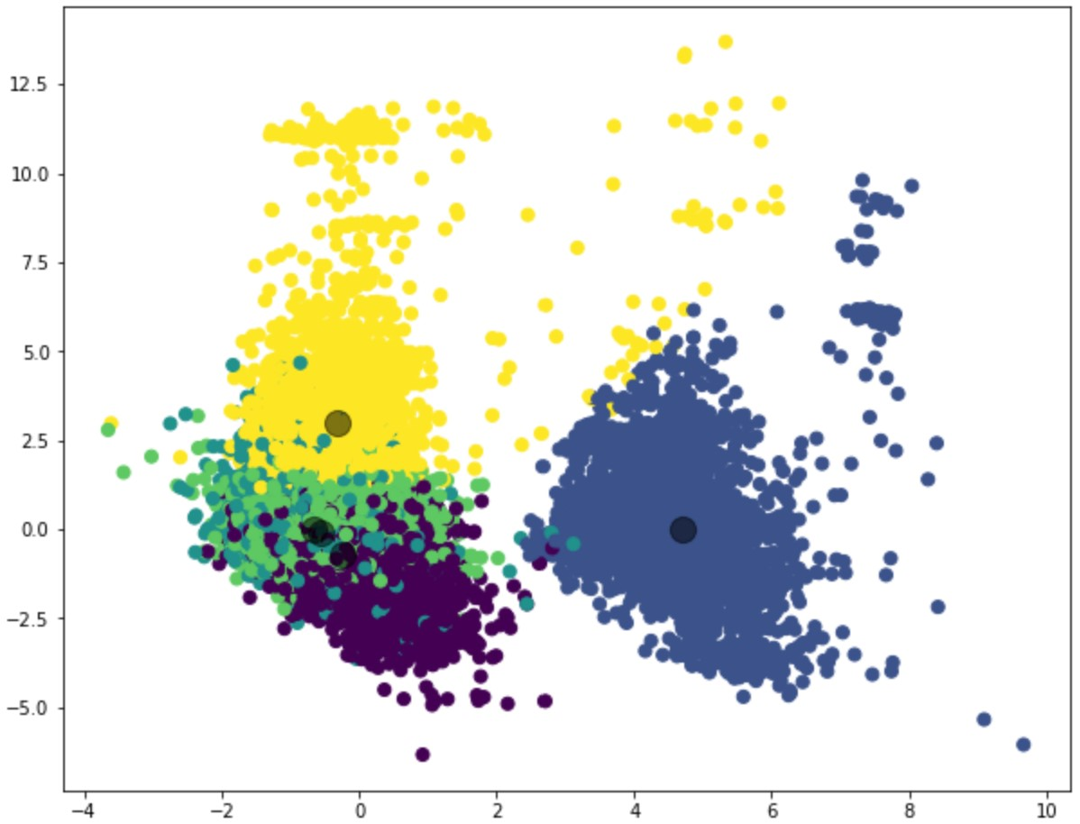
Clustering

Slide 16
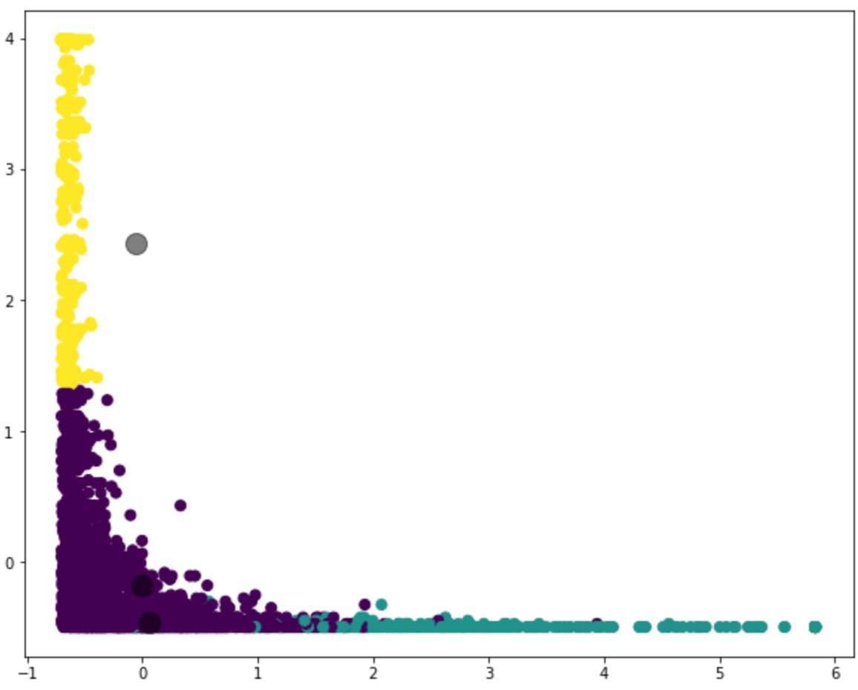
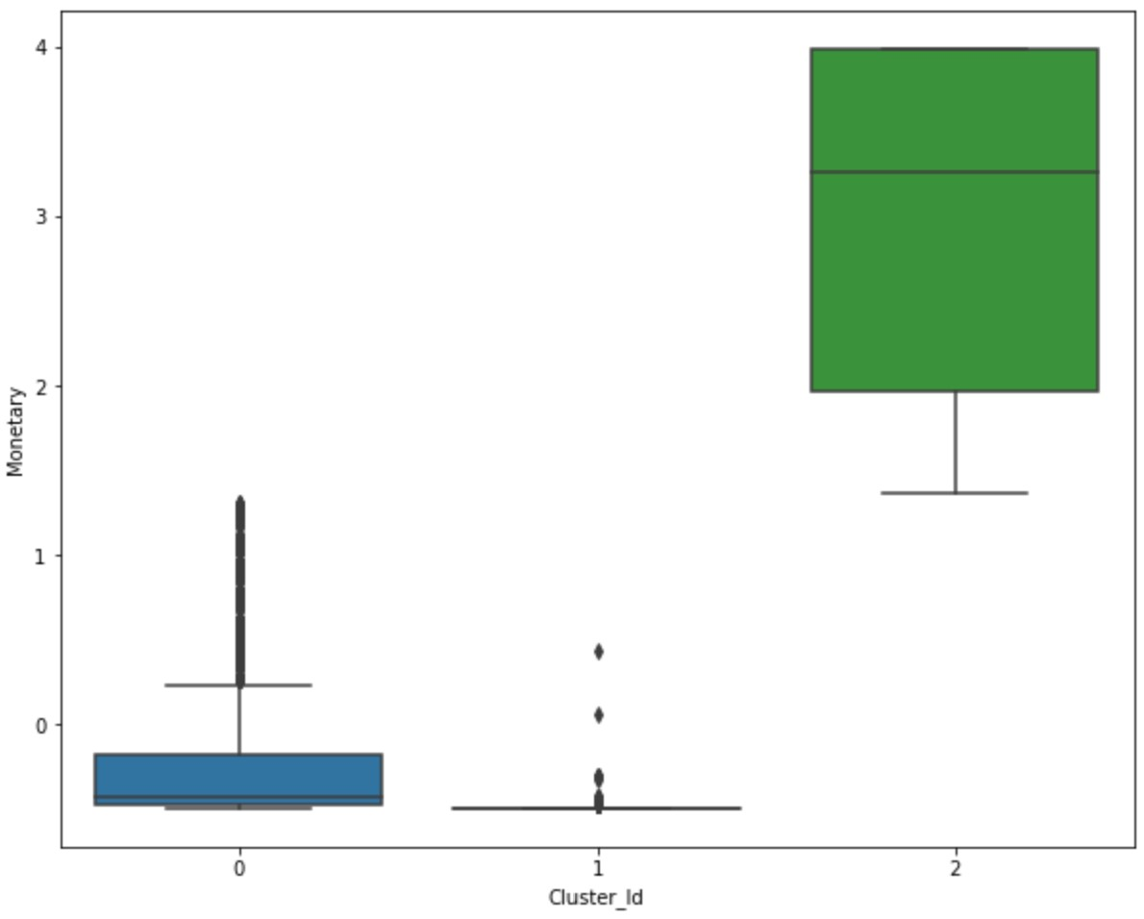
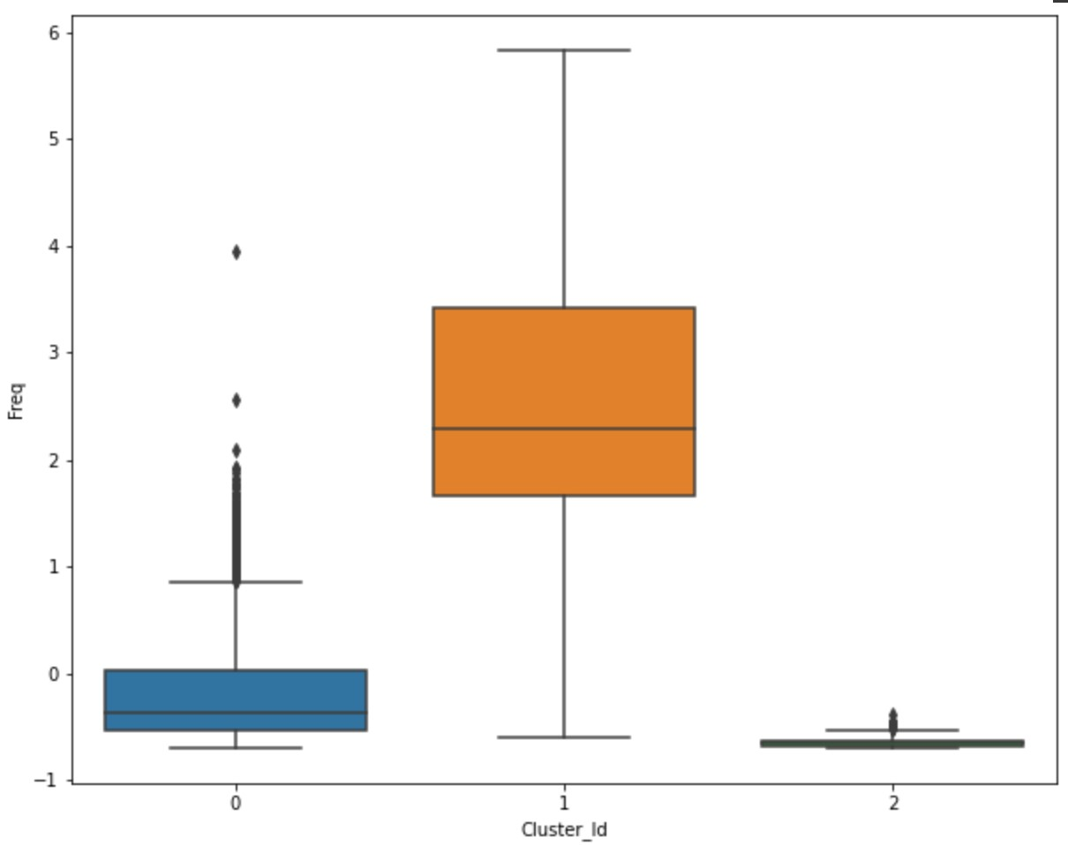
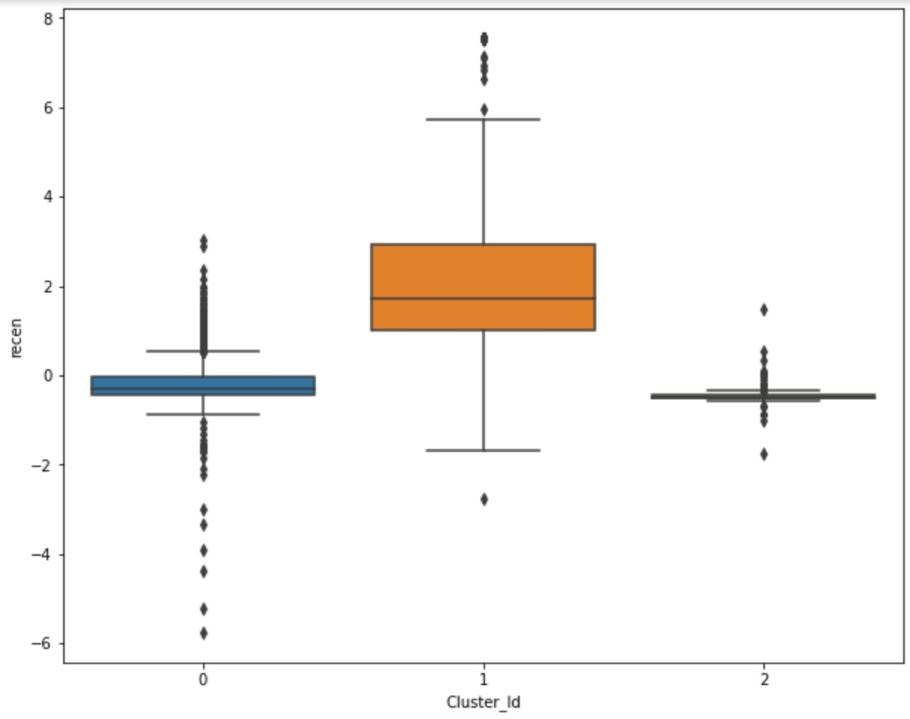
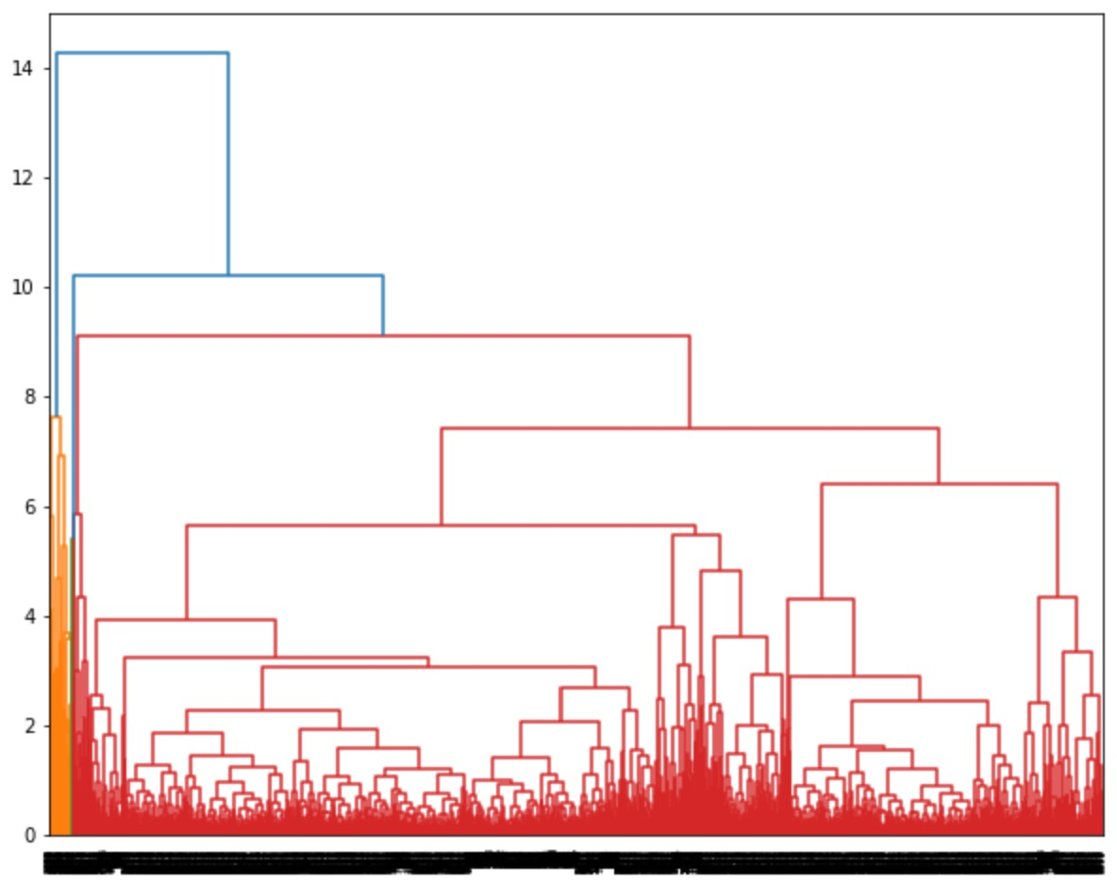
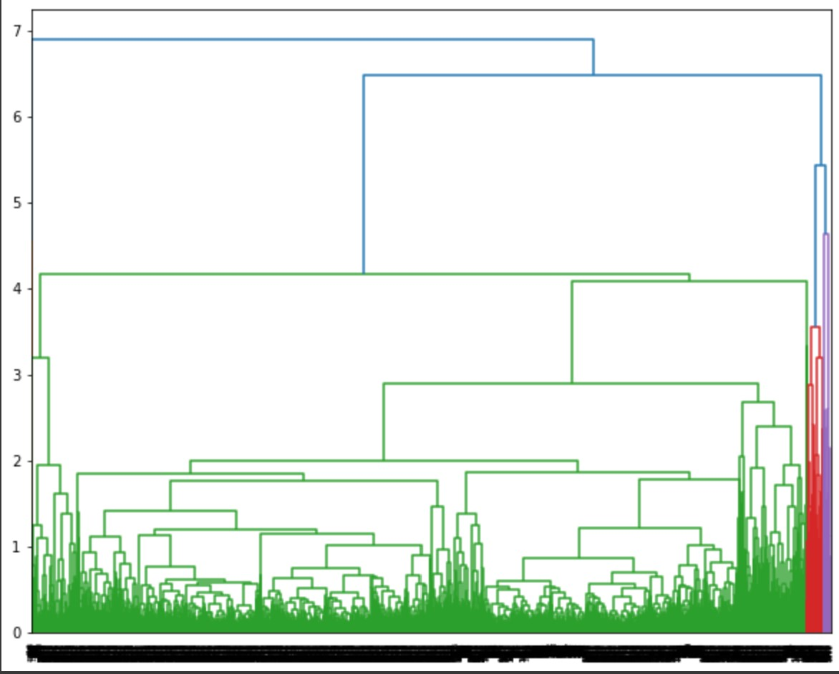
RFM Clustering

Slide 17
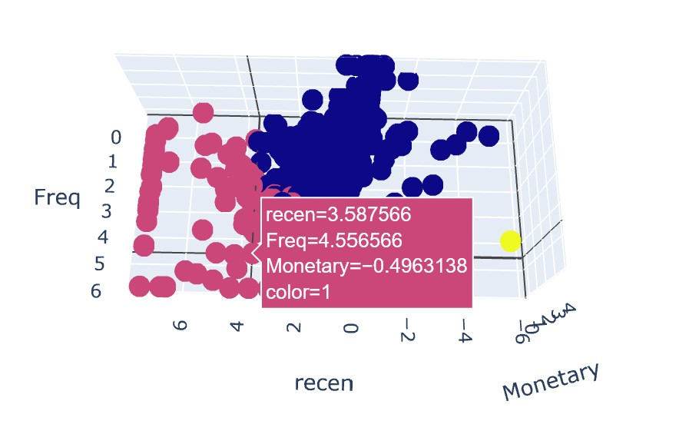
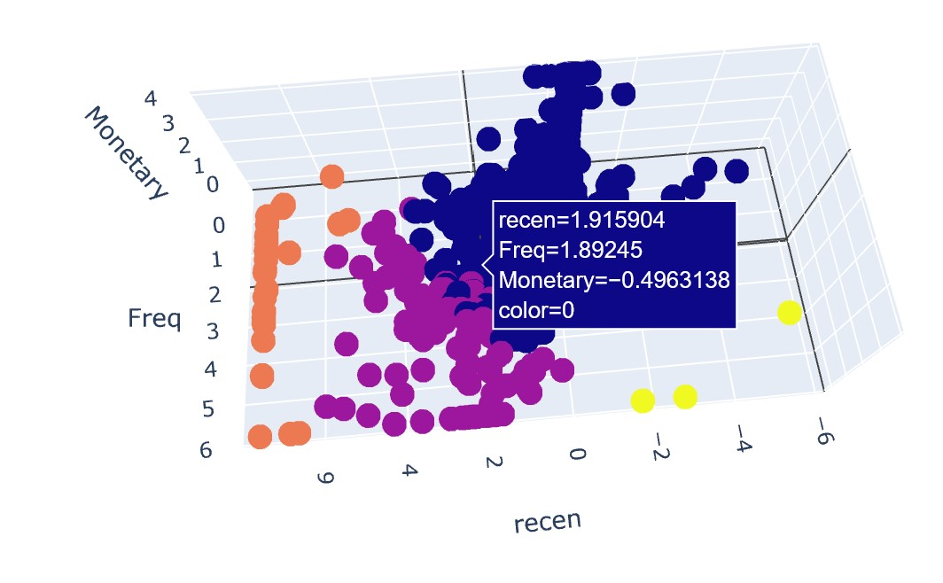
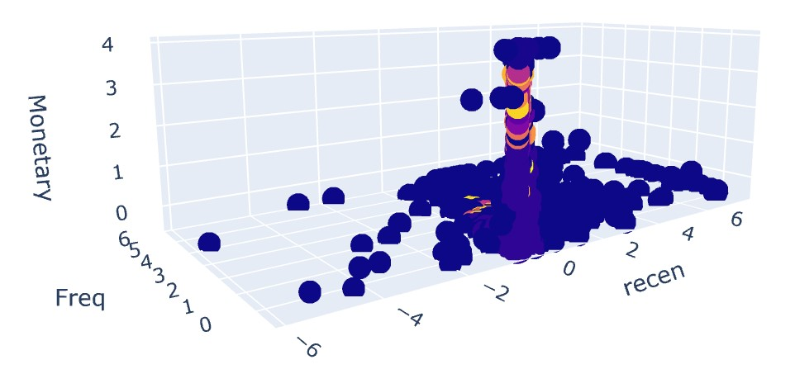
RFM Clustering

Slide 18
Conclusion
That’s all now, I have completed this project. Working on this project gave me a strong understanding of clustering and different clustering techniques. I was able to deliver multiple insights from online retail dataset and perform clustering on it. I also performed RFM analysis. I clustered the dataset using k-means, hierarchical and DBSCAN algorithms and found that the data can be nicely clustered into three groups.

Slide 19
Challenges
The main challenge that I faced in this project was the size of the dataset. I had limited hardware capability that’s why I was not able to perform clustering on whole dataset. After encoding Description and Country features the number of features increased to 4000 approx. When I tried to perform clustering algorithms it was showing full ram memory. Then I sampled 25000 data points from dataset and performed clustering on it.

Slide 20
Thank You

